Slide 1
Creating a bilingual Intelligent Personal Assistant
Nahid Hossain
CSC 4740

Slide 2
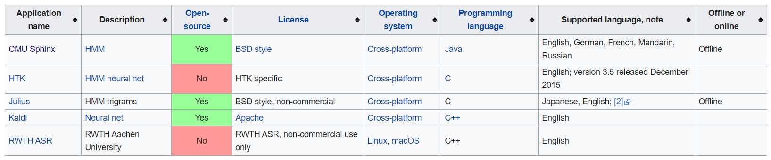
Finding the perfect speech recognition software
Key factors: must be open-source, available on Windows, and programming in Java is preferred

Slide 3
Choosing CMU Sphinx
I chose CMU Sphinx because it met the requirements of all my key factors
CMU Sphinx is made by Carnegie Mellon University(CMU)
It’s ability to create models for languages not currently using the software is perfect for my project
My project’s key purpose is to be able to talk in either English, Bangla(or Bengali), and Banglish, a word used to describe the hybrid language of Bangla and English, and be able to get feedback in them respectively

Slide 4
What else does CMU Sphinx have to offer
The GitHub website for CMU Sphinx offers a tutorial on how to handle most of the software
They have their own web based tool, known as lmtool, which allows users to create two important text- based components
One is the lexical model and the other is the language model
The lexical model is essentially the dictionary of words that are going to be used for speaking and being understood by the software
The language model is basically like a list of combinations of words from the lexical model

Slide 5
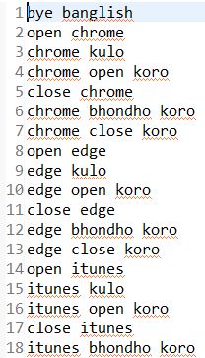
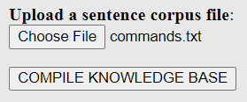

Web Based tool Process
Step 1: Create a file with a list of commands as shown on the right (tutorial said to name the file as corpus.txt, I named the file as commands.txt) Step 2: Select that file you created as shown on the left Step 3: Finally click on the Compile Knowledge Base Button

Slide 6
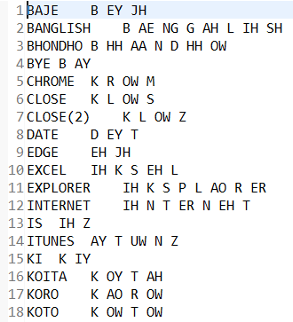
Pronunciation Dictionary(.dic) File Example
Output 1
This is the same thing as the lexical model.

Slide 7
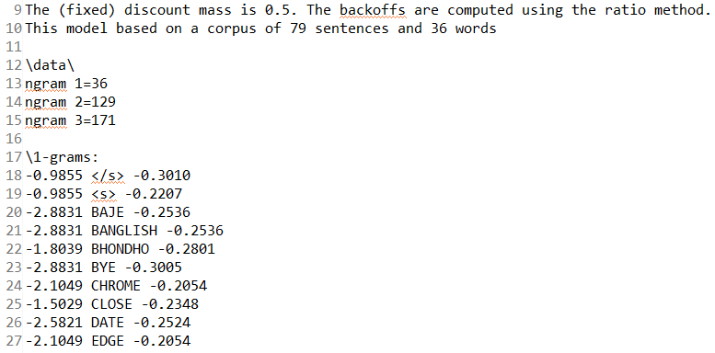
Language Model(.lm) File Example
Output 2

Slide 8

Configuration Setup
Output 1 is used in line 3 while Output 2 is used in line 4. I did not make an acoustic model, which is basically like a huge dictionary. CMU provides users with their one which includes multiple different languages as well.

Slide 9
Some methods that I have made
Open “Program Name”
Close “Program Name”
What is the time
What is the date
These methods have their Bangla and Banglish equivalents
I coded the equivalents in the Latin transliteration
I made the statement “Bye Banglish” close the Intelligent Personal Assistant
Commands not understood are not taken in and asked to be repeated by the user

Slide 10
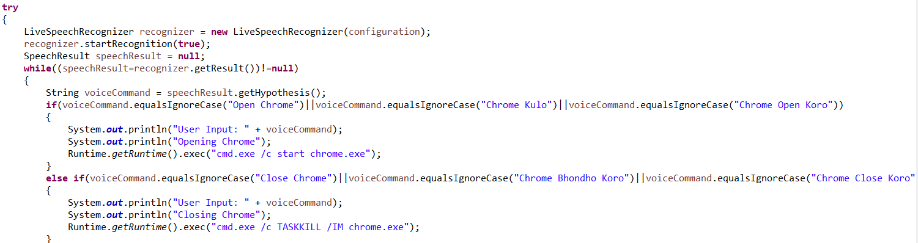
Examples of Code

Slide 11
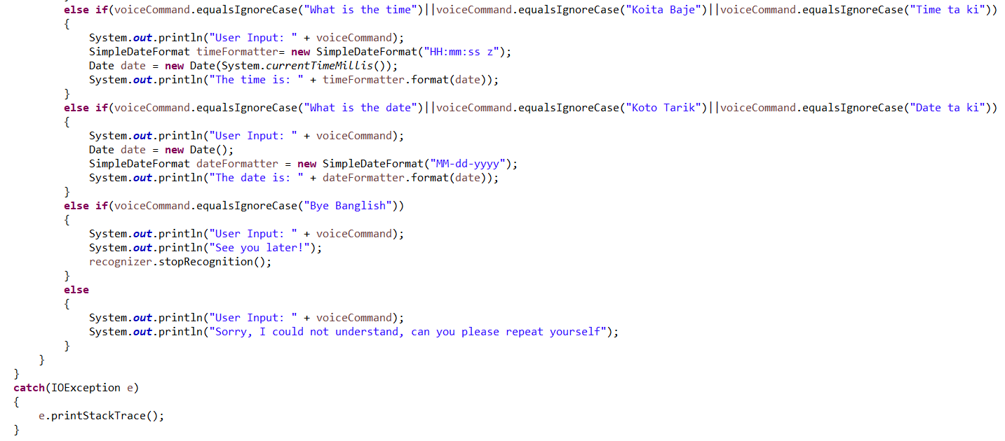

Slide 12
Remaining Plans
I need to find a way for the speech to be read out loud to the user
This will make the Intelligent Personal Assistant into a Voice User Interface
Some examples of Voice User Interfaces include Siri, Alexa, Cortana, Echo, etc.

Slide 13
Sources
https://en.wikipedia.org/wiki/List_of_speech_recognition_software
https://cmusphinx.github.io/
http://www.speech.cs.cmu.edu/tools/lmtool-new.html

